Slide 1
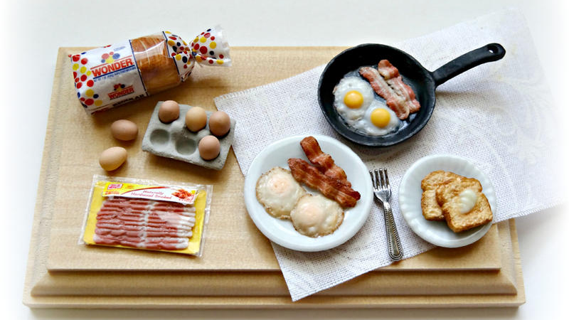
TASTY BYTES Enhancing Recipe Discoverability: A Machine Learning Approach
Driving Engagement and Traffic for Tasty Bytes

Slide 2
Introduction
Problem Statement:
Determine which recipes will receive a lot of traffic.
With an 80% likelihood, estimate which recipes will have "High" traffic values.
This would allow Tasty Bytes to better curate their website with the most traffic gaining recipes.

Slide 3
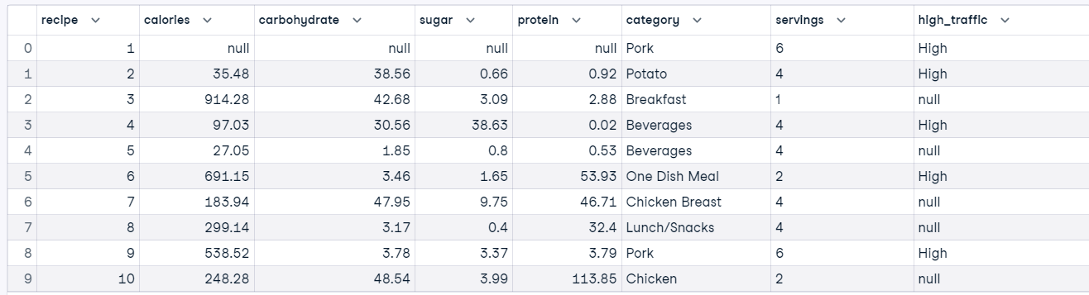
Overview of Data Provided
947 rows, 8 columns.
4 numeric, 3 categorical

Slide 4
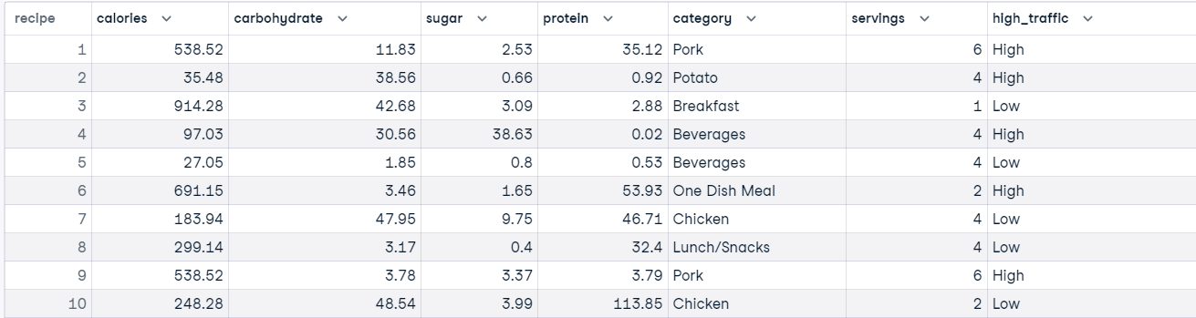
Prepared Data

Slide 5



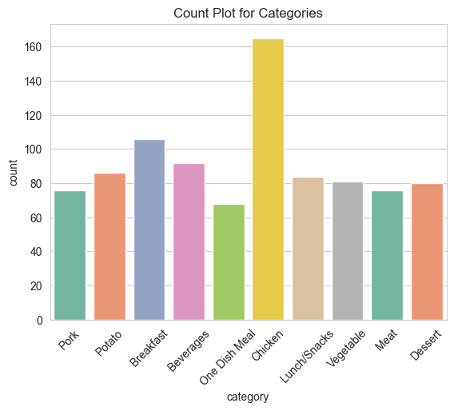
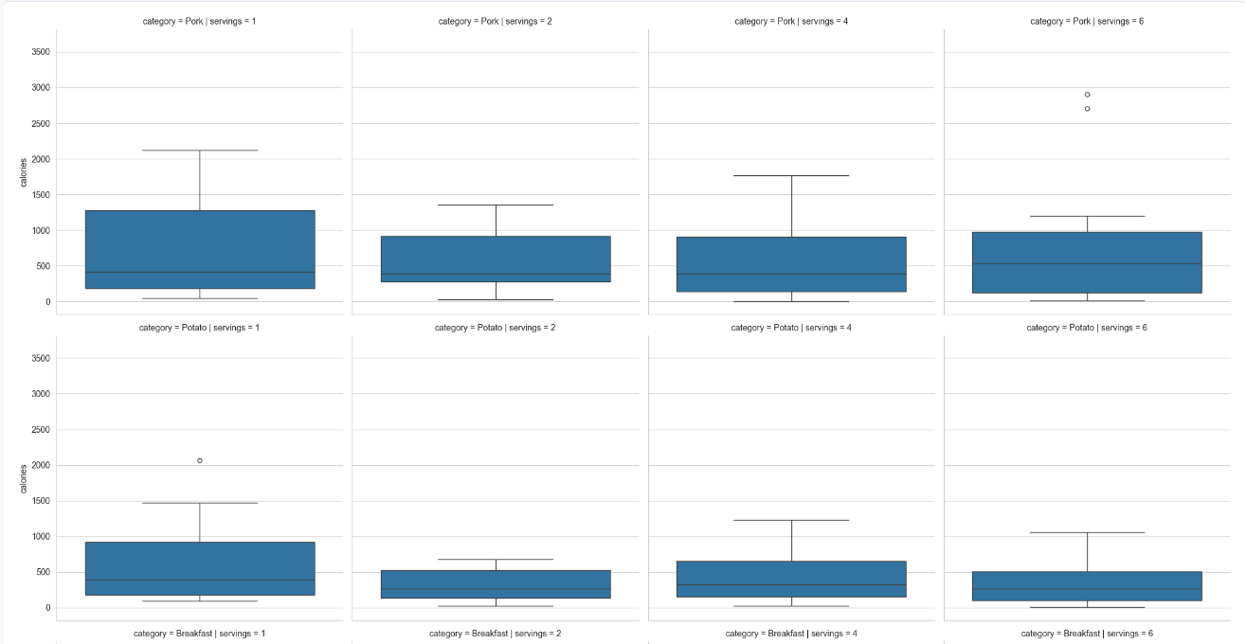
Data Analysis (1)
Count Plot: Counts of each category. Chicken is the most frequent, and One Dish Meal the least appearing in the dataset.
Box Plot: Y- axis: Calories. Rows: Categories. Columns: Servings. 160 plots (10x4x4)

Slide 6
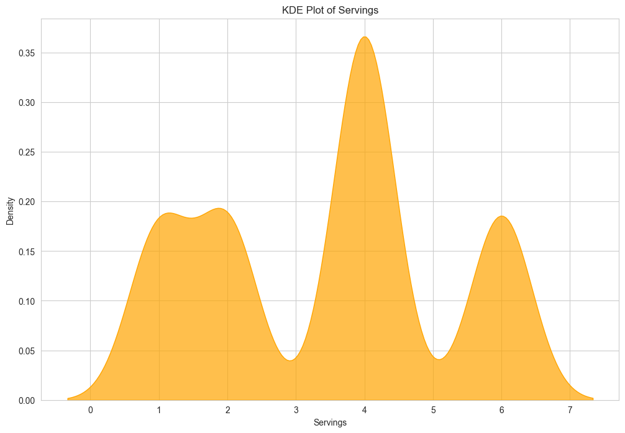
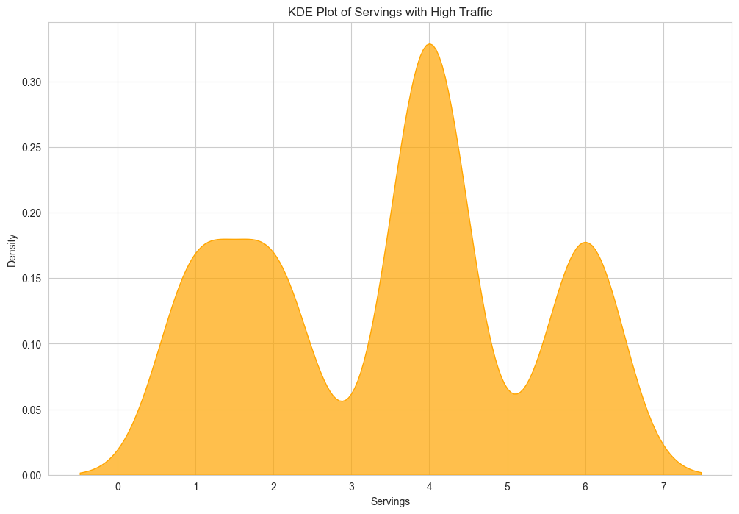
Data Analysis (2)
All
Only for High Traffic

Slide 7
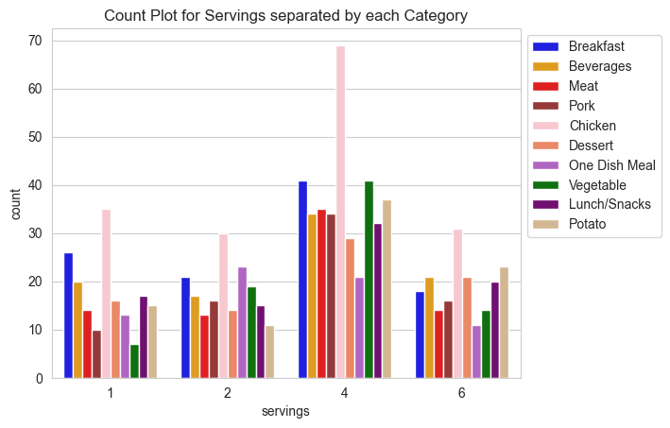
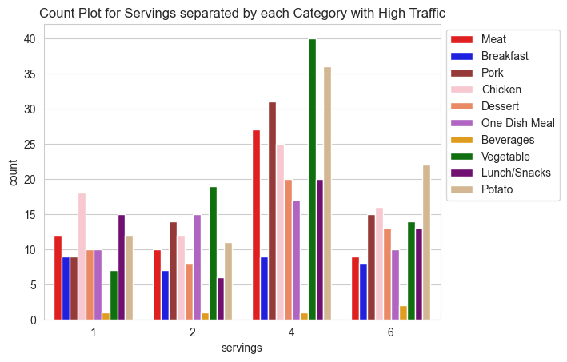
Data Analysis (2)
All
Only for High Traffic

Slide 8
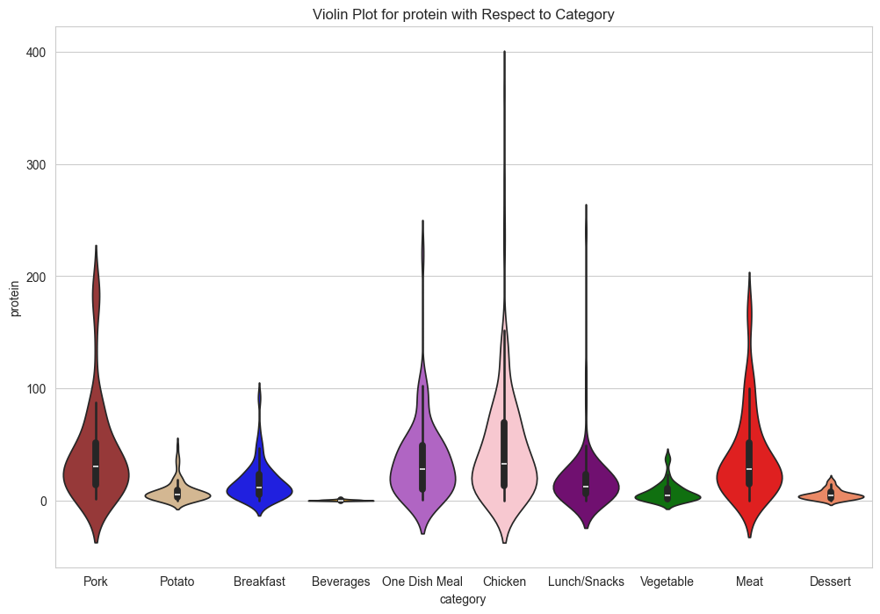
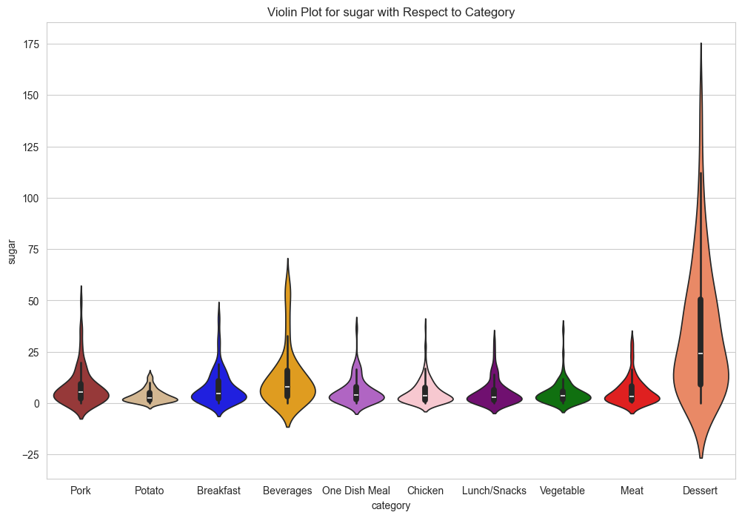
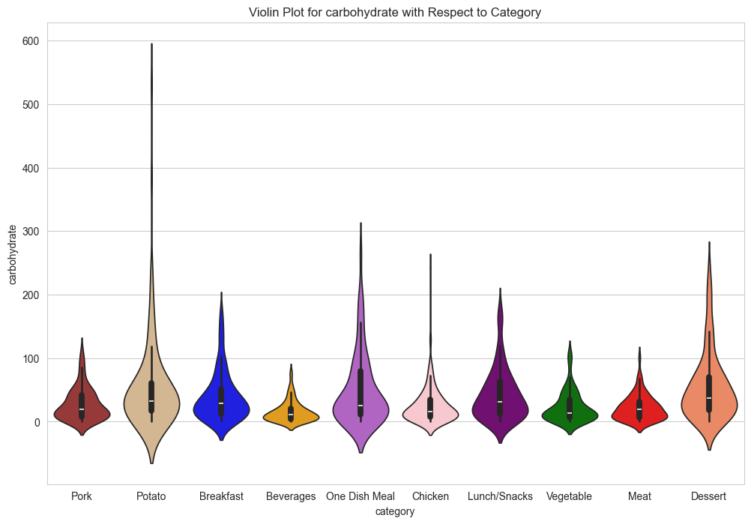
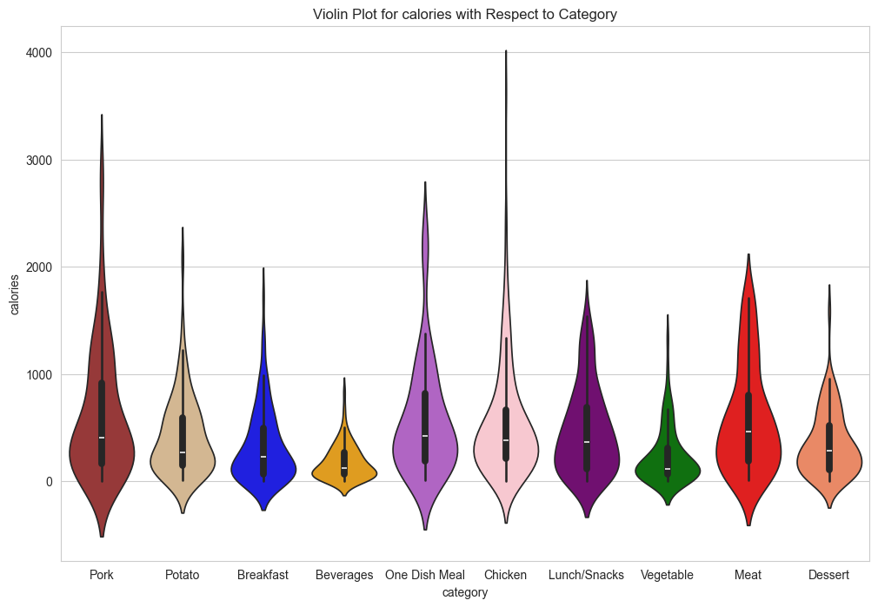
Data Analysis (3)
Protein
Sugar
The food types accurately represent their respective health metrics.
For example: Meats are high in protein, potato is high in carbohydrates, and Dessert is high in sugar.
Carbohydrates
Calories

Slide 9
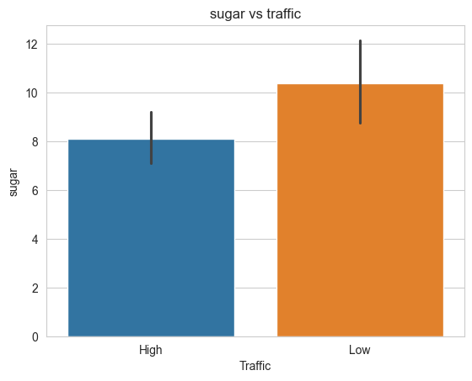
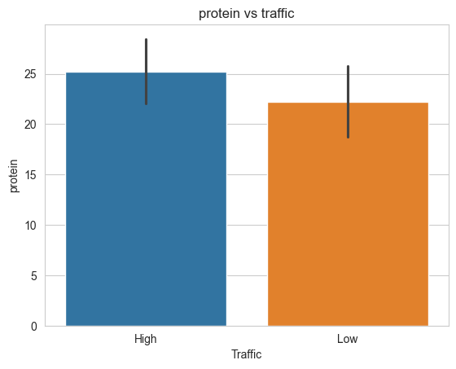
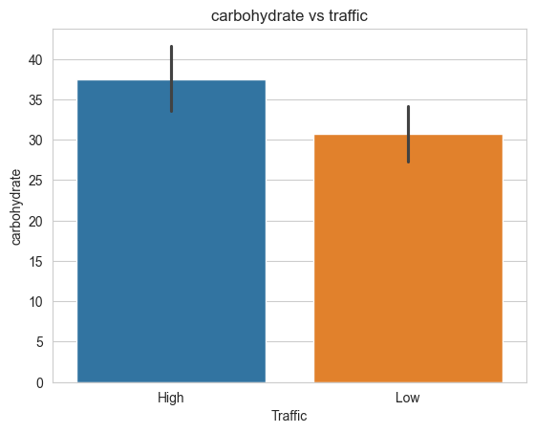
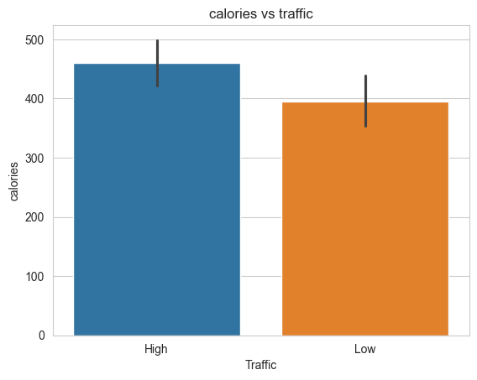
Data Analysis (4)
The numeric columns with respect to the traffic give us a good idea of what recipes work and what don’t.
We can see that sugary delights may not be your most profitable recipe, and that recipes heavy in carbohydrates might be the ideal one to garner momentum.

Slide 10
Models Used
Base Model:
Logistic Regression: Good for Binary Classification Problems
Comparison Models:
RandomForestClassifier
GradientBoostingClassifier
LinearSVC
Naive Bayes
RandomForestClassifier with Bagging
KNeighborsClassifier
ExtraTrees Classifier

Slide 11
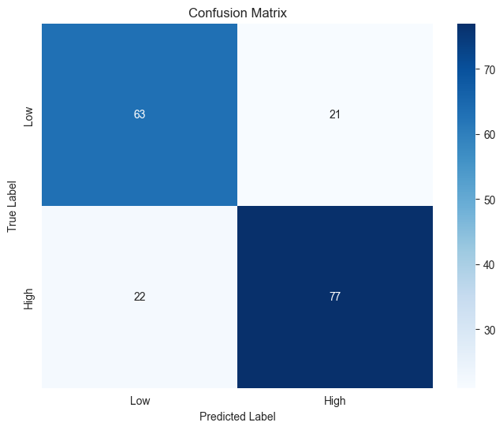
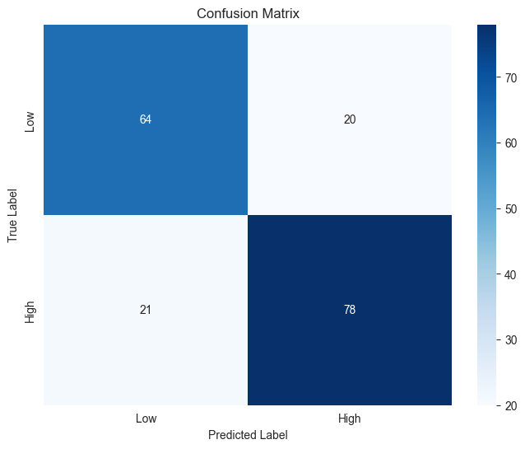
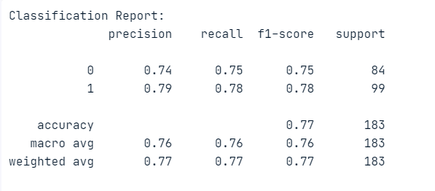
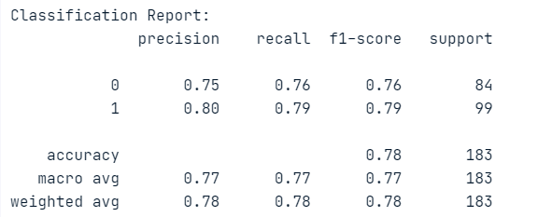

Model Evaluation and KPIs
The Logistic Regression performs better but only slightly.
Both models have been evaluated with well preprocessed data and GridSearchCV for best hyperparameter tuning.
The initial KPI would be that of the accuracy. But we suggest using AUC ROC score as a more evolved KPI.
SVM
Logistic Regression

Slide 12
Business Impact
Flagship Recipes
Strategic Content Curation
Targeted Marketing
Collaborations and Partnerships
Diversification of Content
User Engagement Strategies

Slide 13
Recommendations
Use ROC AUC Score as KPI
Deploy model, but with supervision of experienced data analysts
Leverage larger dataset, consider new features
Establish routine retraining of the model to keep up with current trends
Explore cost-effective and performance-oriented solutions for implementing the machine learning model, preferably on edge devices

Slide 14
THANK YOU!

